Slide 1

Team
Tech Hawks
PrecisionAgriCare: Empowering Farmers

Slide 2
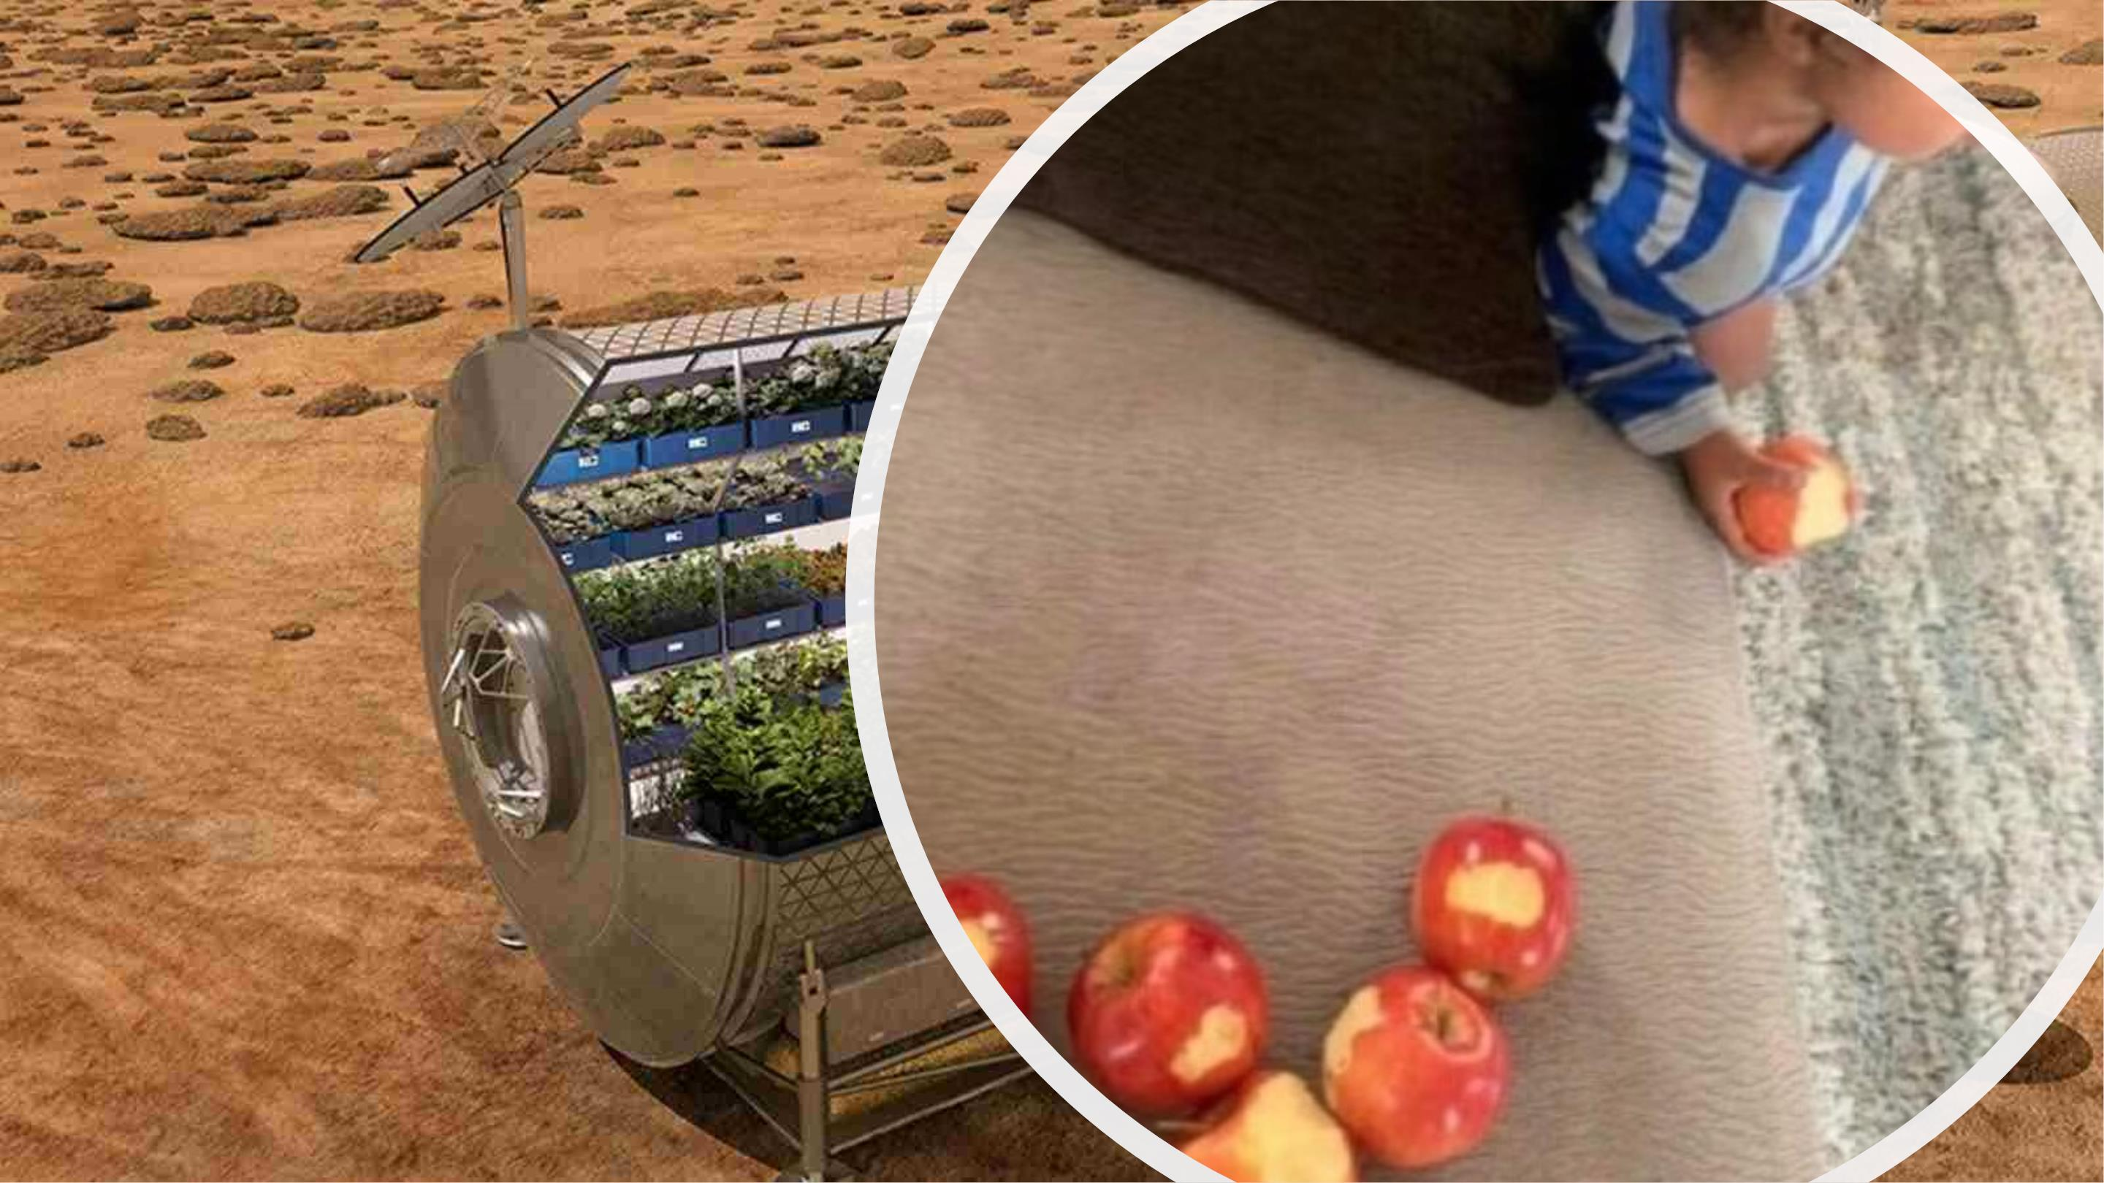

Slide 3
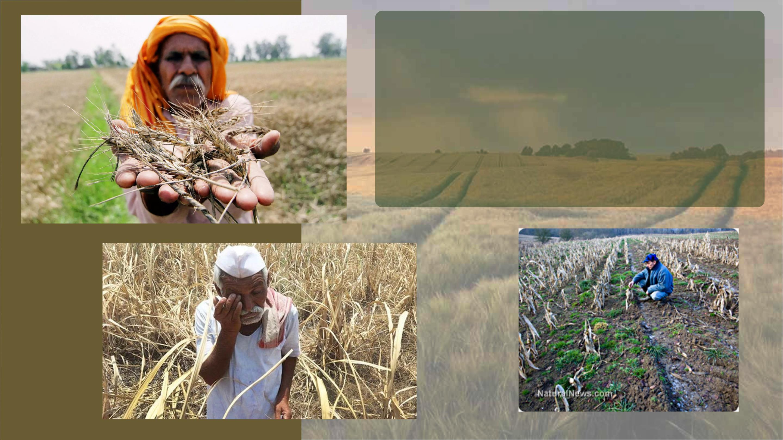
Theꢀagriculturalꢀsectorꢀfacesꢀsignificantꢀchallengesꢀin
achievingꢀsustainableꢀdevelopment.ꢀFarmersꢀstruggleꢀw
uncertaintyꢀwhenꢀitꢀcomesꢀtoꢀselectingꢀtheꢀrightꢀcropsꢀfor
landꢀandꢀoptimizingꢀresourceꢀutilization.ꢀExcessiveꢀuse
syntheticꢀfertilizersꢀandꢀpesticidesꢀharmsꢀtheꢀenvironmen
posesꢀrisksꢀtoꢀfoodꢀsafety.

Slide 4

- Uncertainty in crop selection for farmers
due to varying land conditions
- Excessive use of synthetic fertilizers and
pesticides leading to environmental harm
- Lack of real-time data on crucial factors
like soil moisture, temperature, and nutrient
levels
- Limited access to market information for
fair trade and maximizing income potential
- Inefficient resource utilization and
suboptimal crop yields
- Lack of transparency and direct trade
relationships between farmers and
consumers

Slide 5
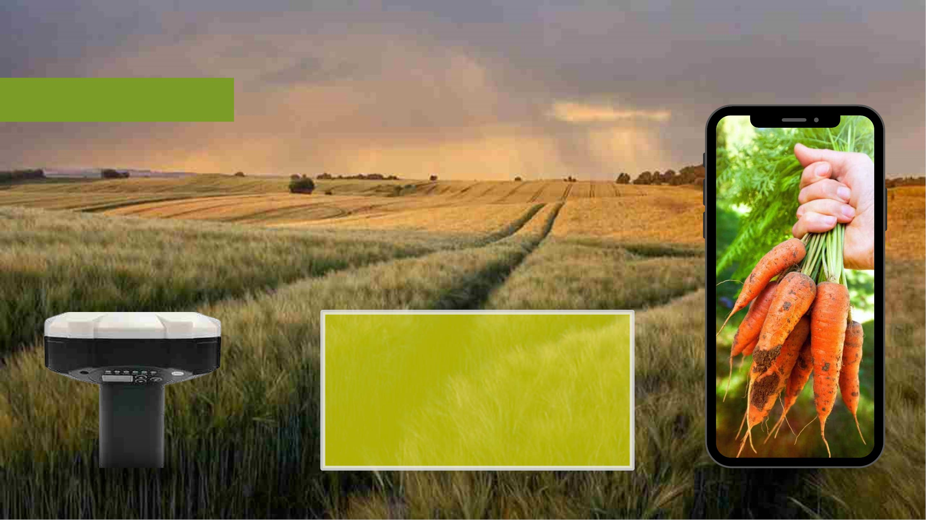
OurꢀSolution
ꢀdeviceꢀ
+
mobileꢀapplication
WhatꢀWeꢀꢀ
Suggest
Aꢀdeviceꢀandꢀmobileꢀapplicationꢀnotꢀonlyꢀtoꢀ
identifyꢀaꢀsuitableꢀcropꢀforꢀaꢀgivenꢀlandꢀbutꢀalsoꢀtoꢀ
navigateꢀtheꢀfarmerꢀstartingꢀfromꢀseedingꢀtoꢀ
harvestingꢀstepꢀbyꢀstepꢀforꢀaꢀbetterꢀharvest.

Slide 6
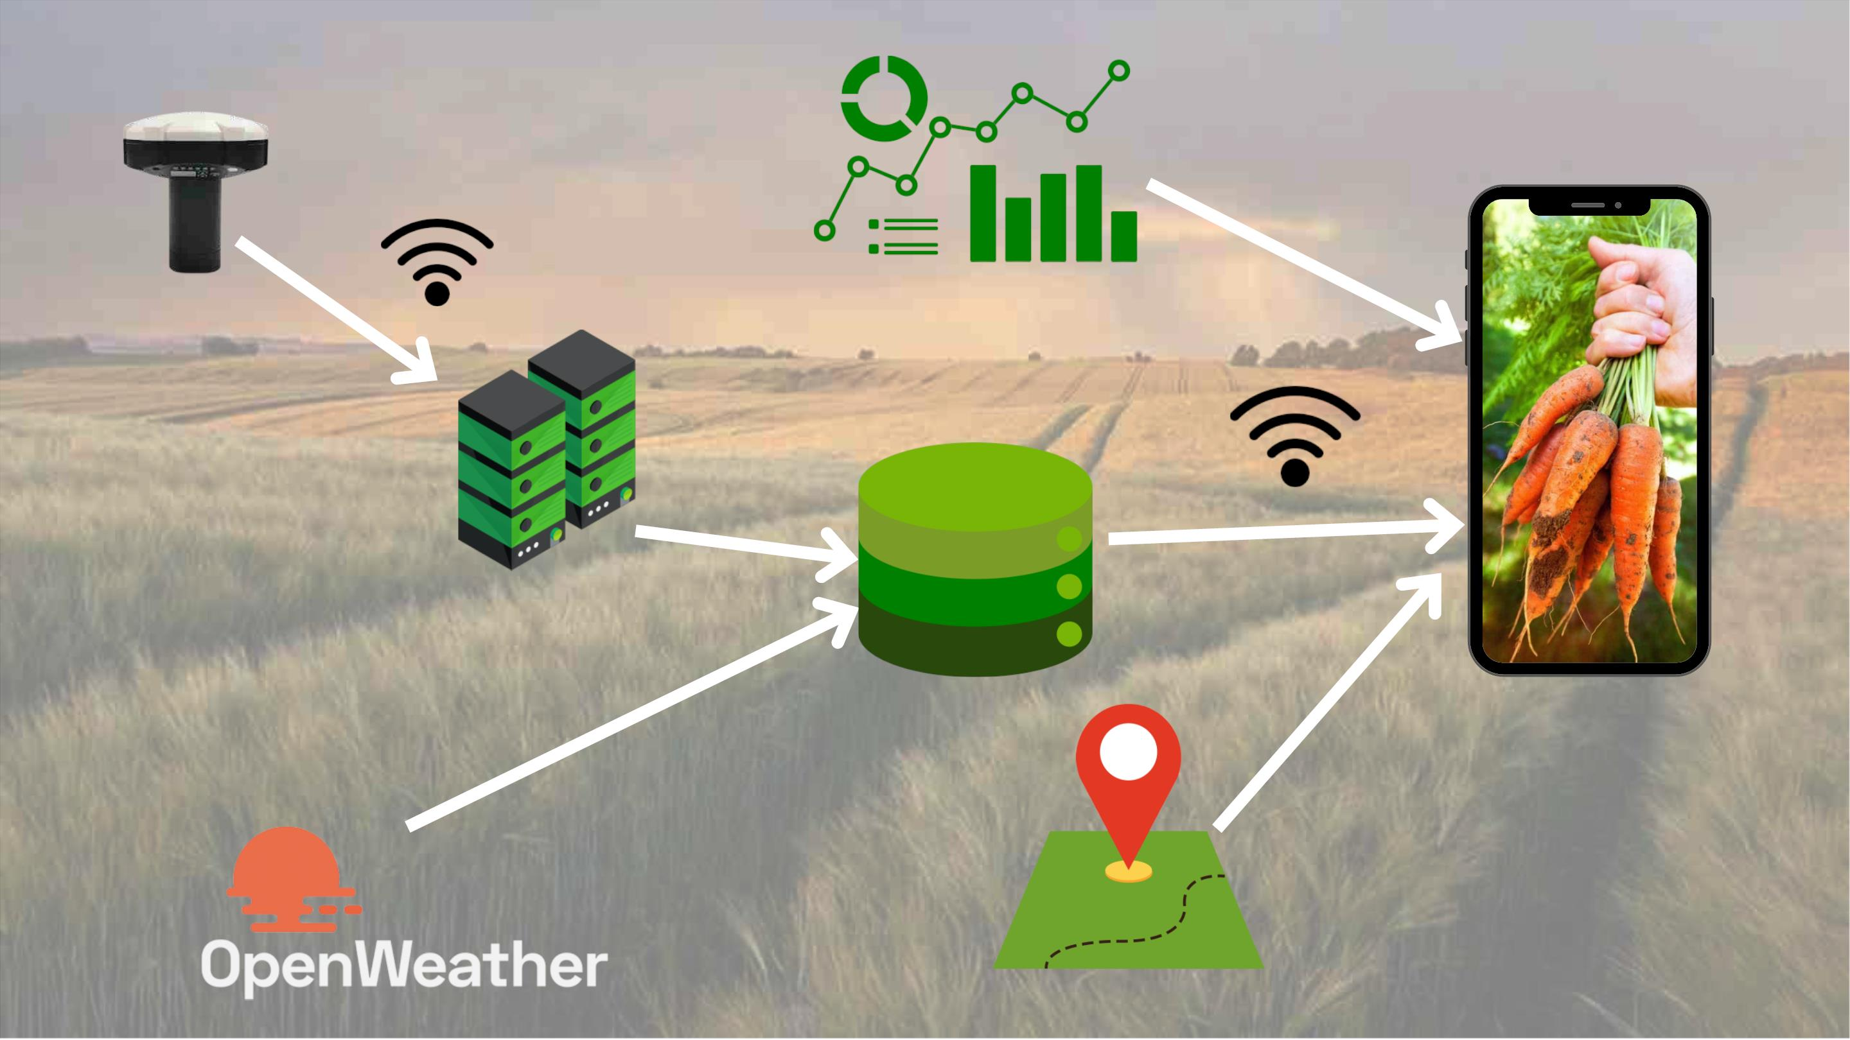

Slide 7
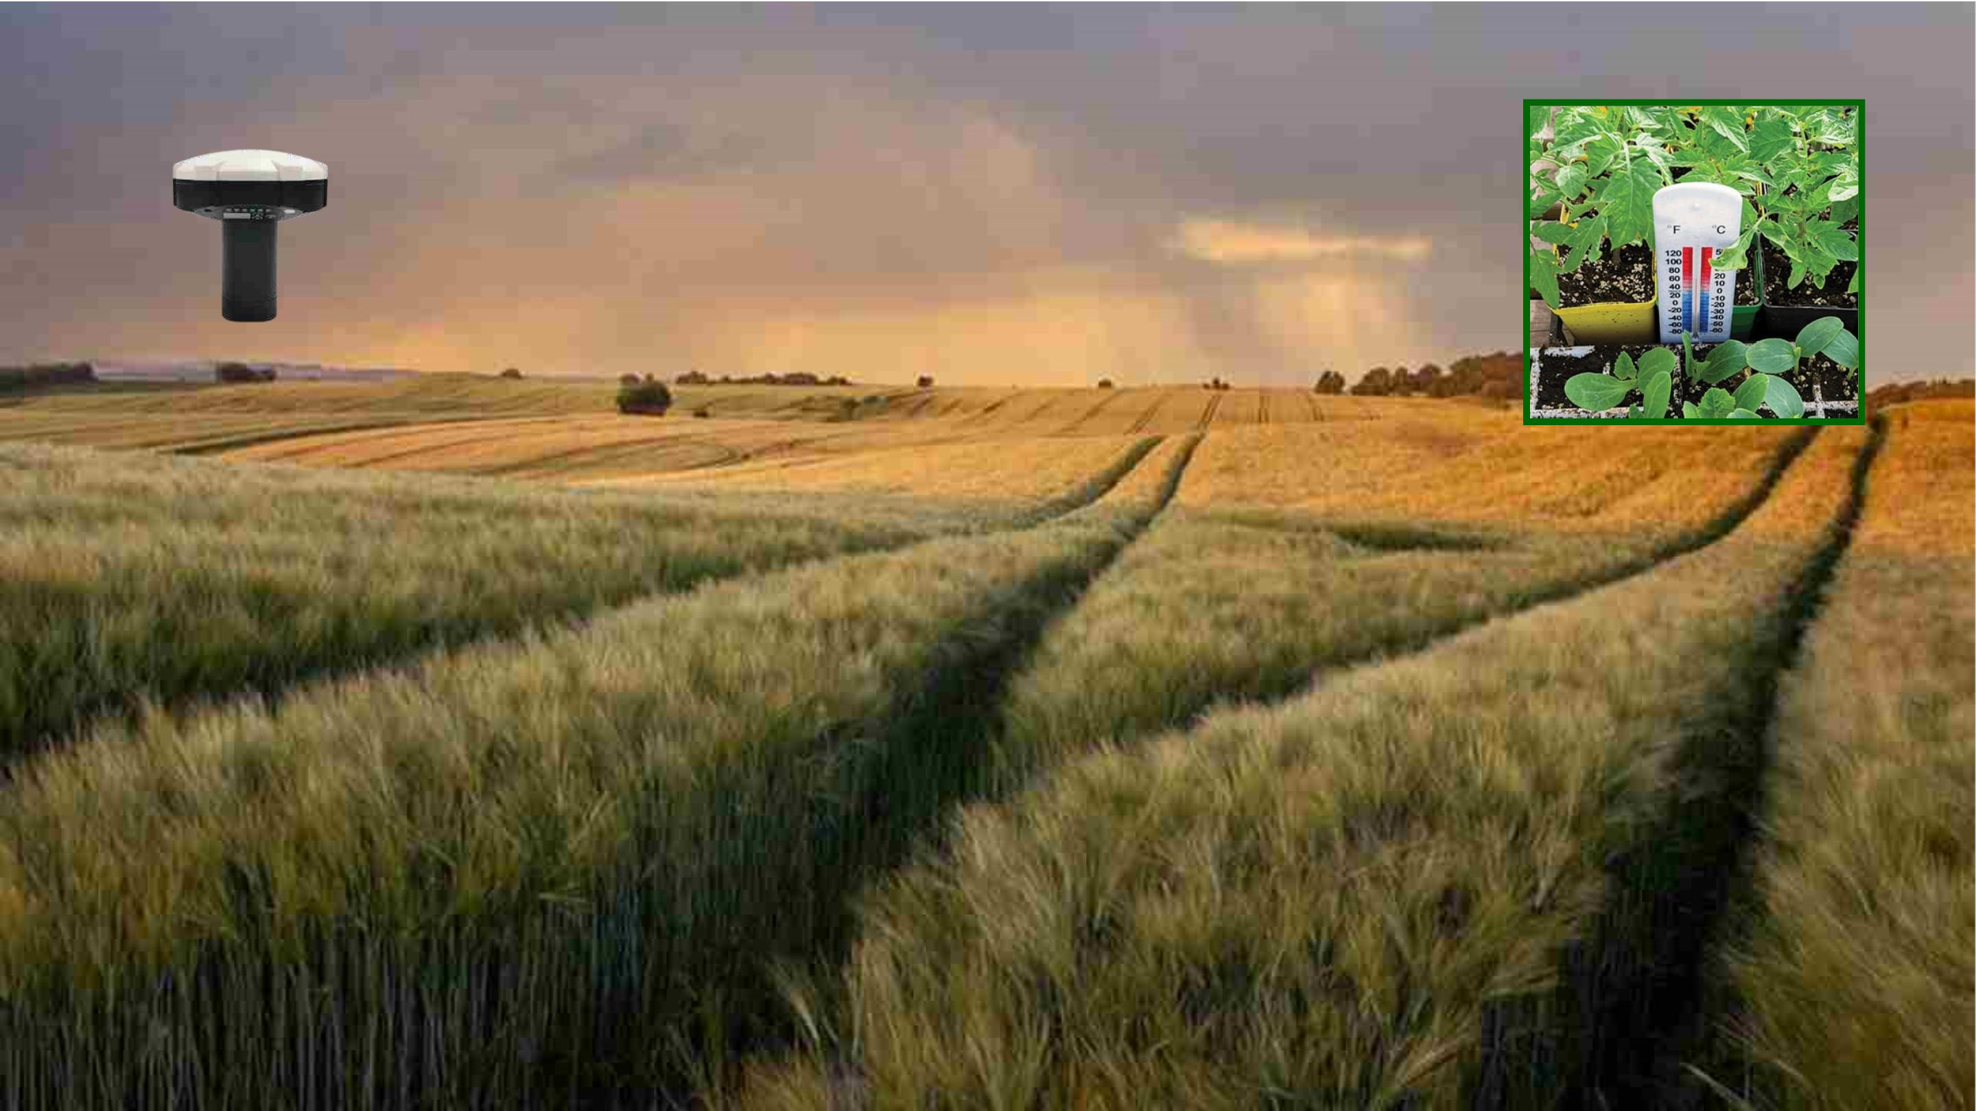

Slide 8
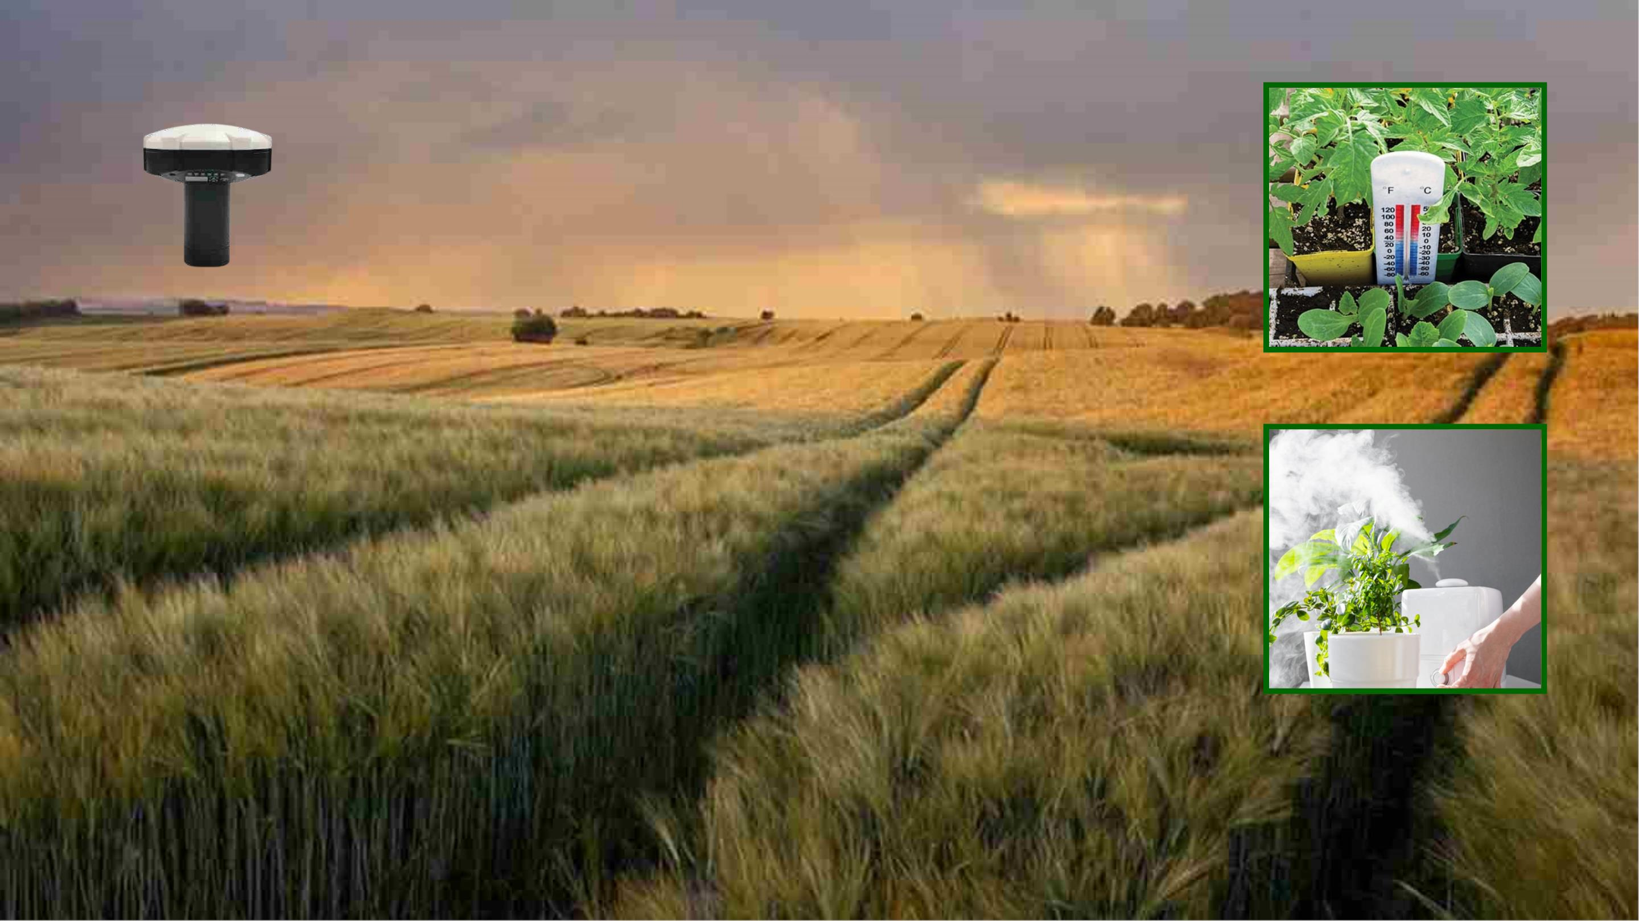

Slide 9
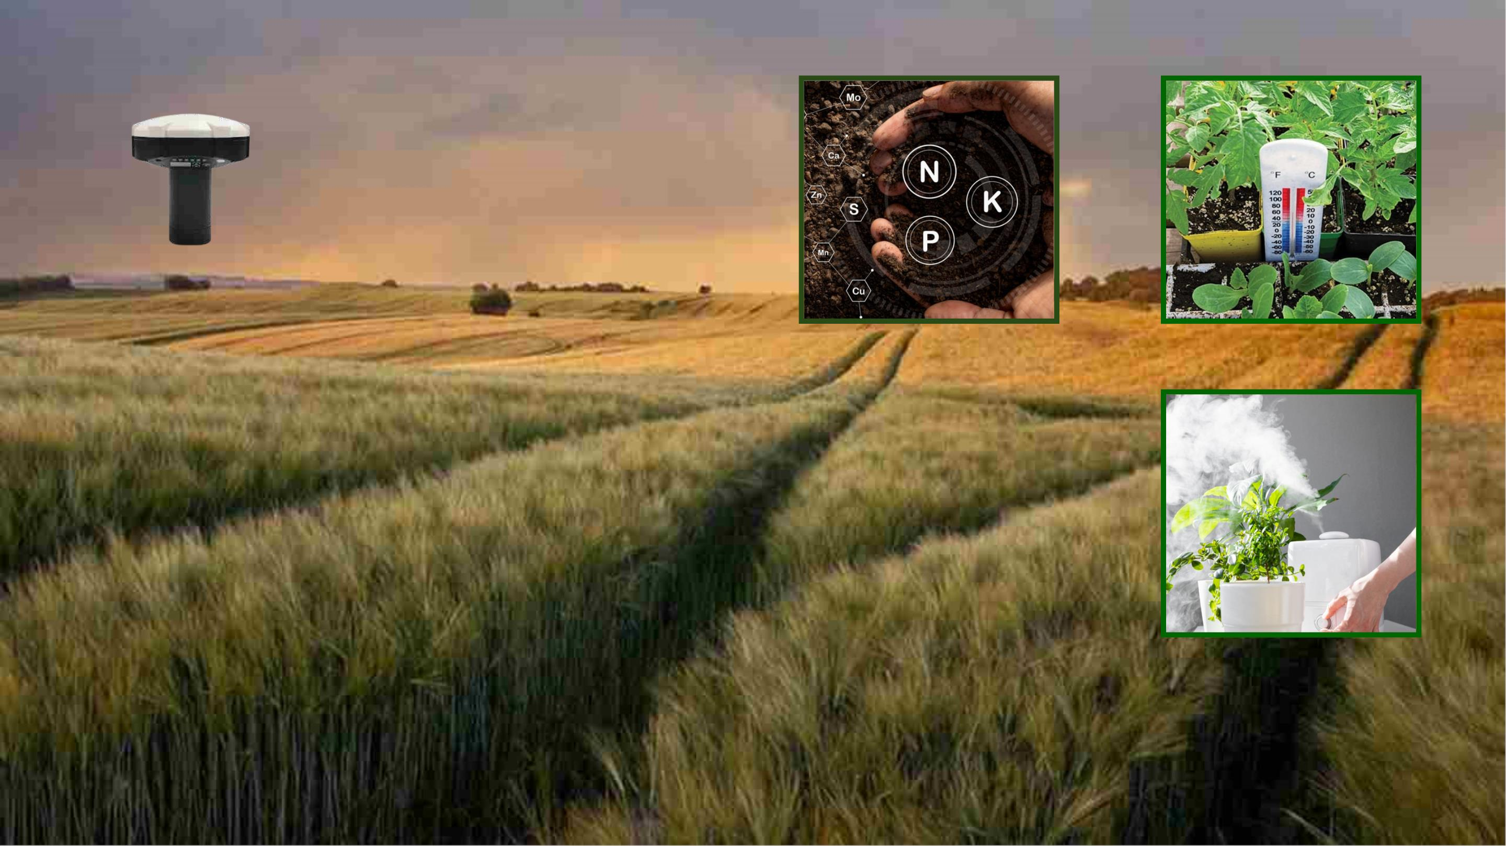

Slide 10
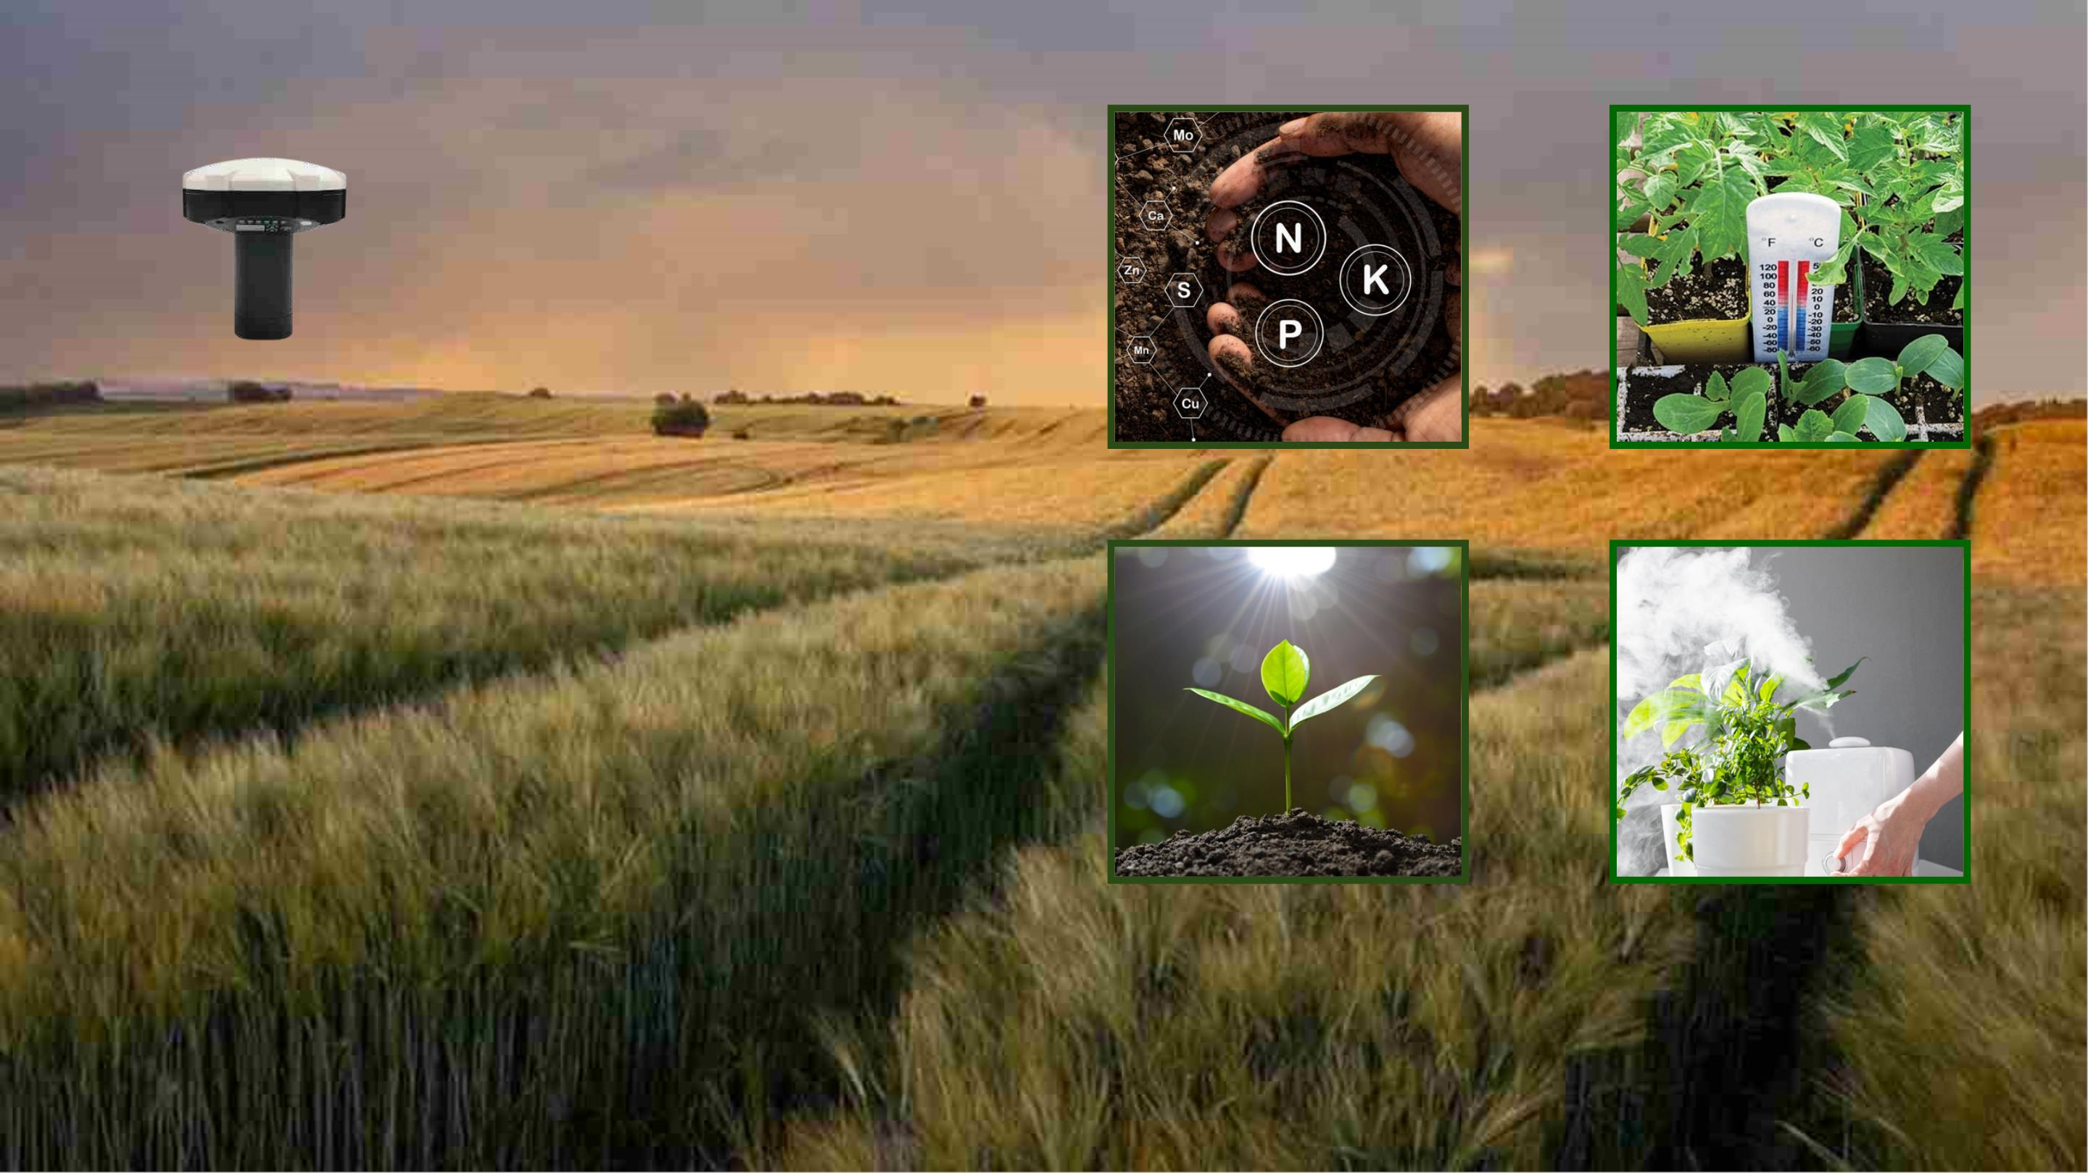

Slide 11
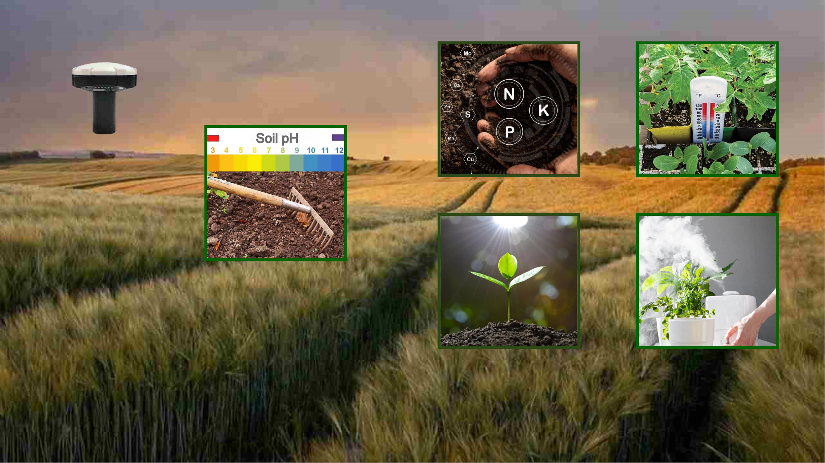

Slide 12
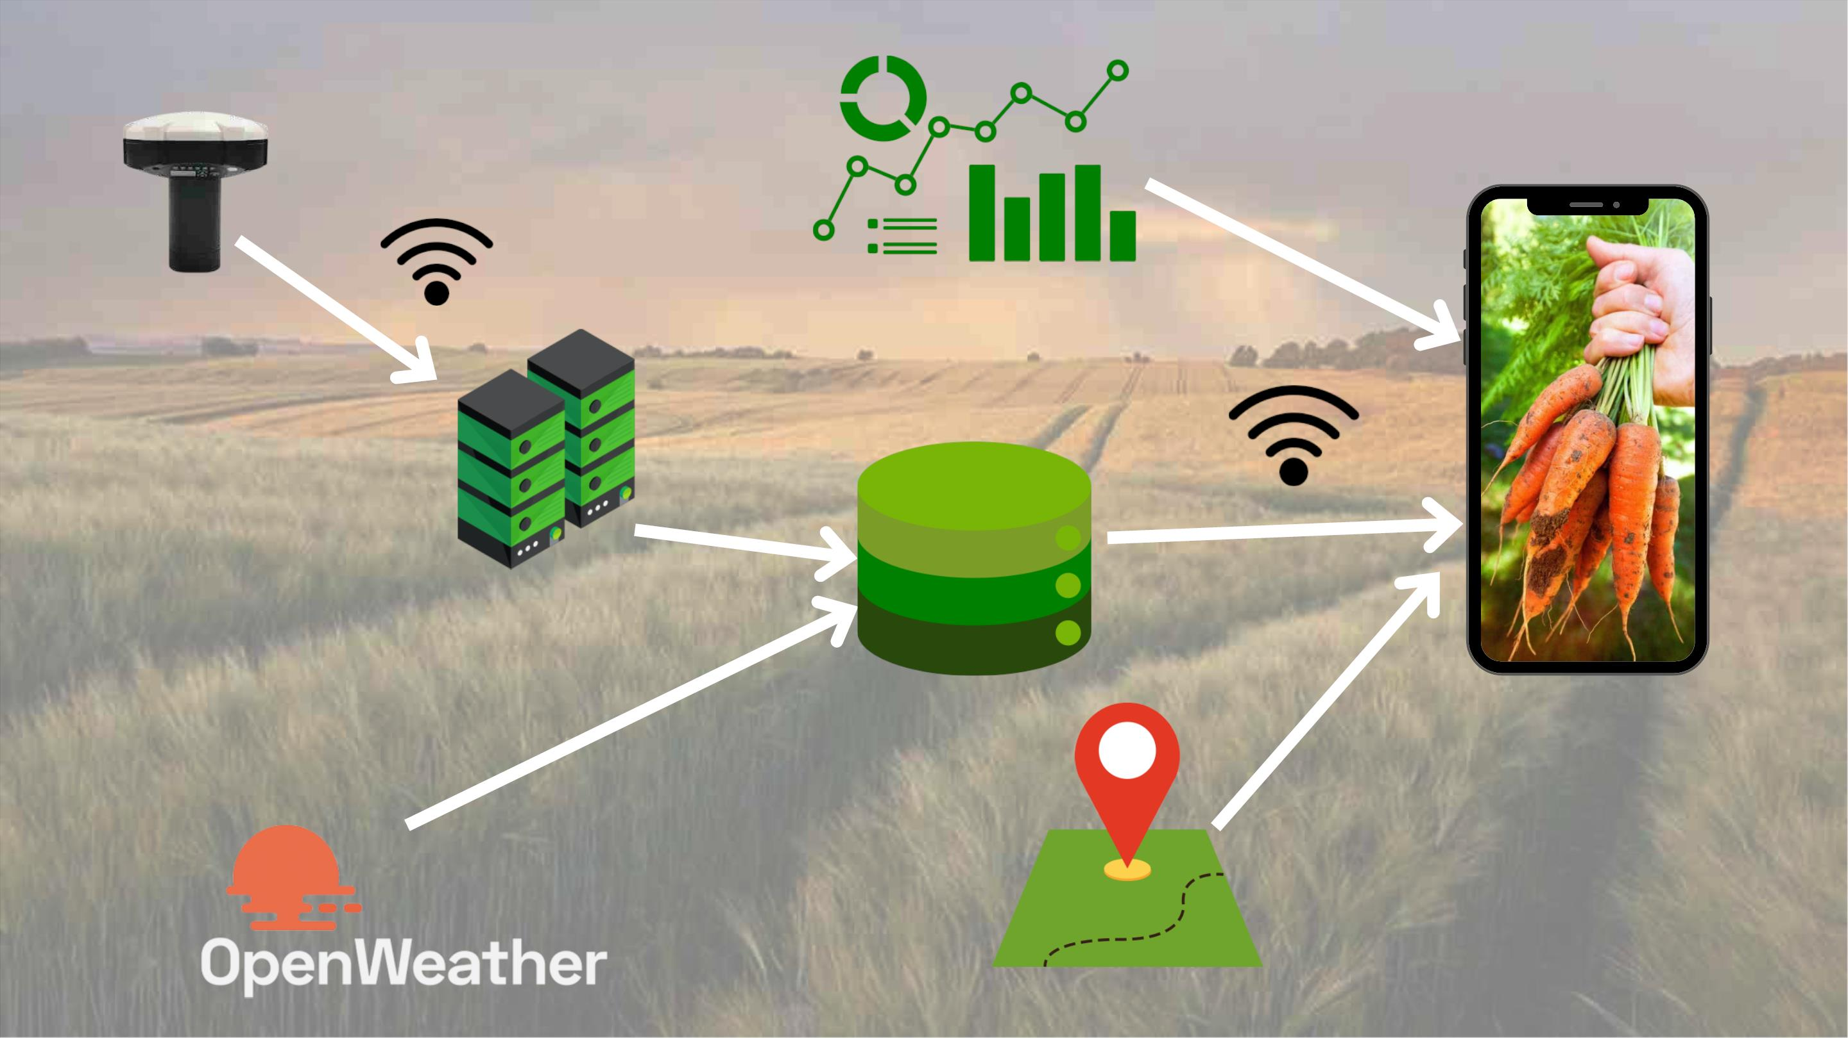

Slide 13
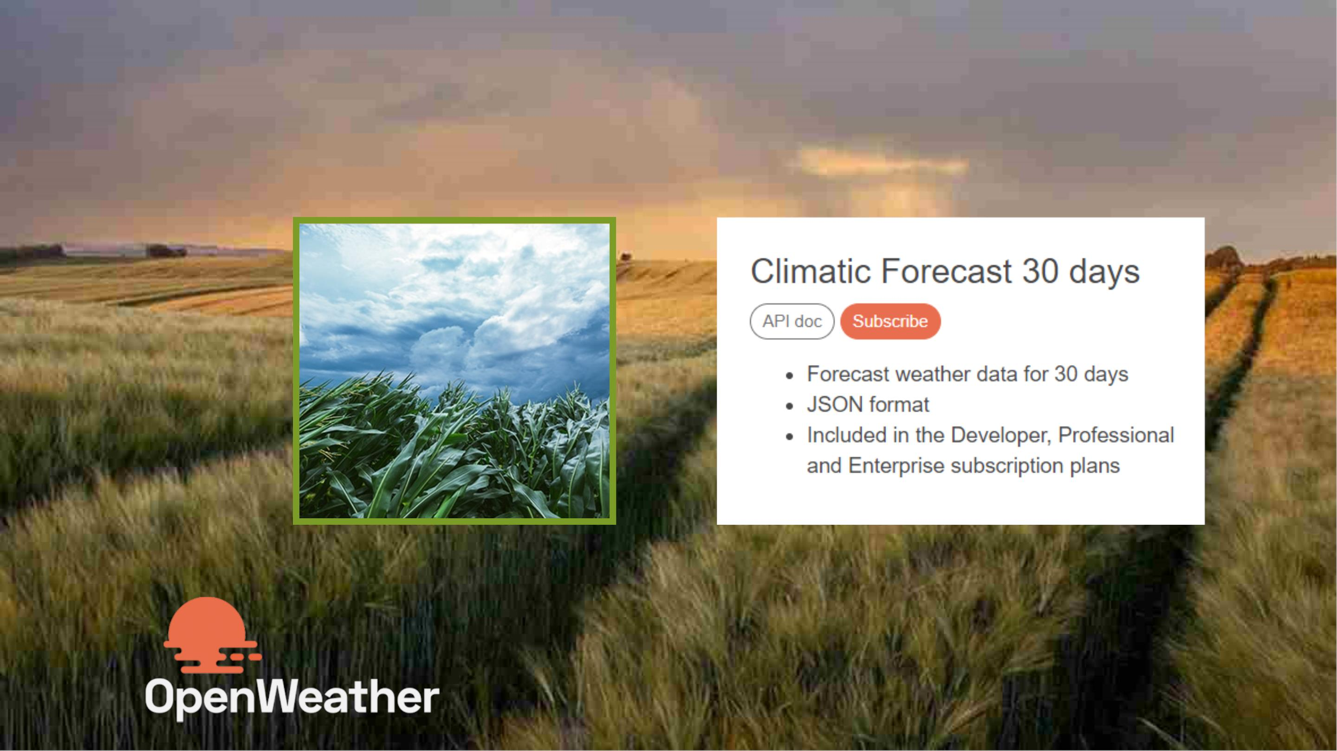

Slide 15


Slide 17
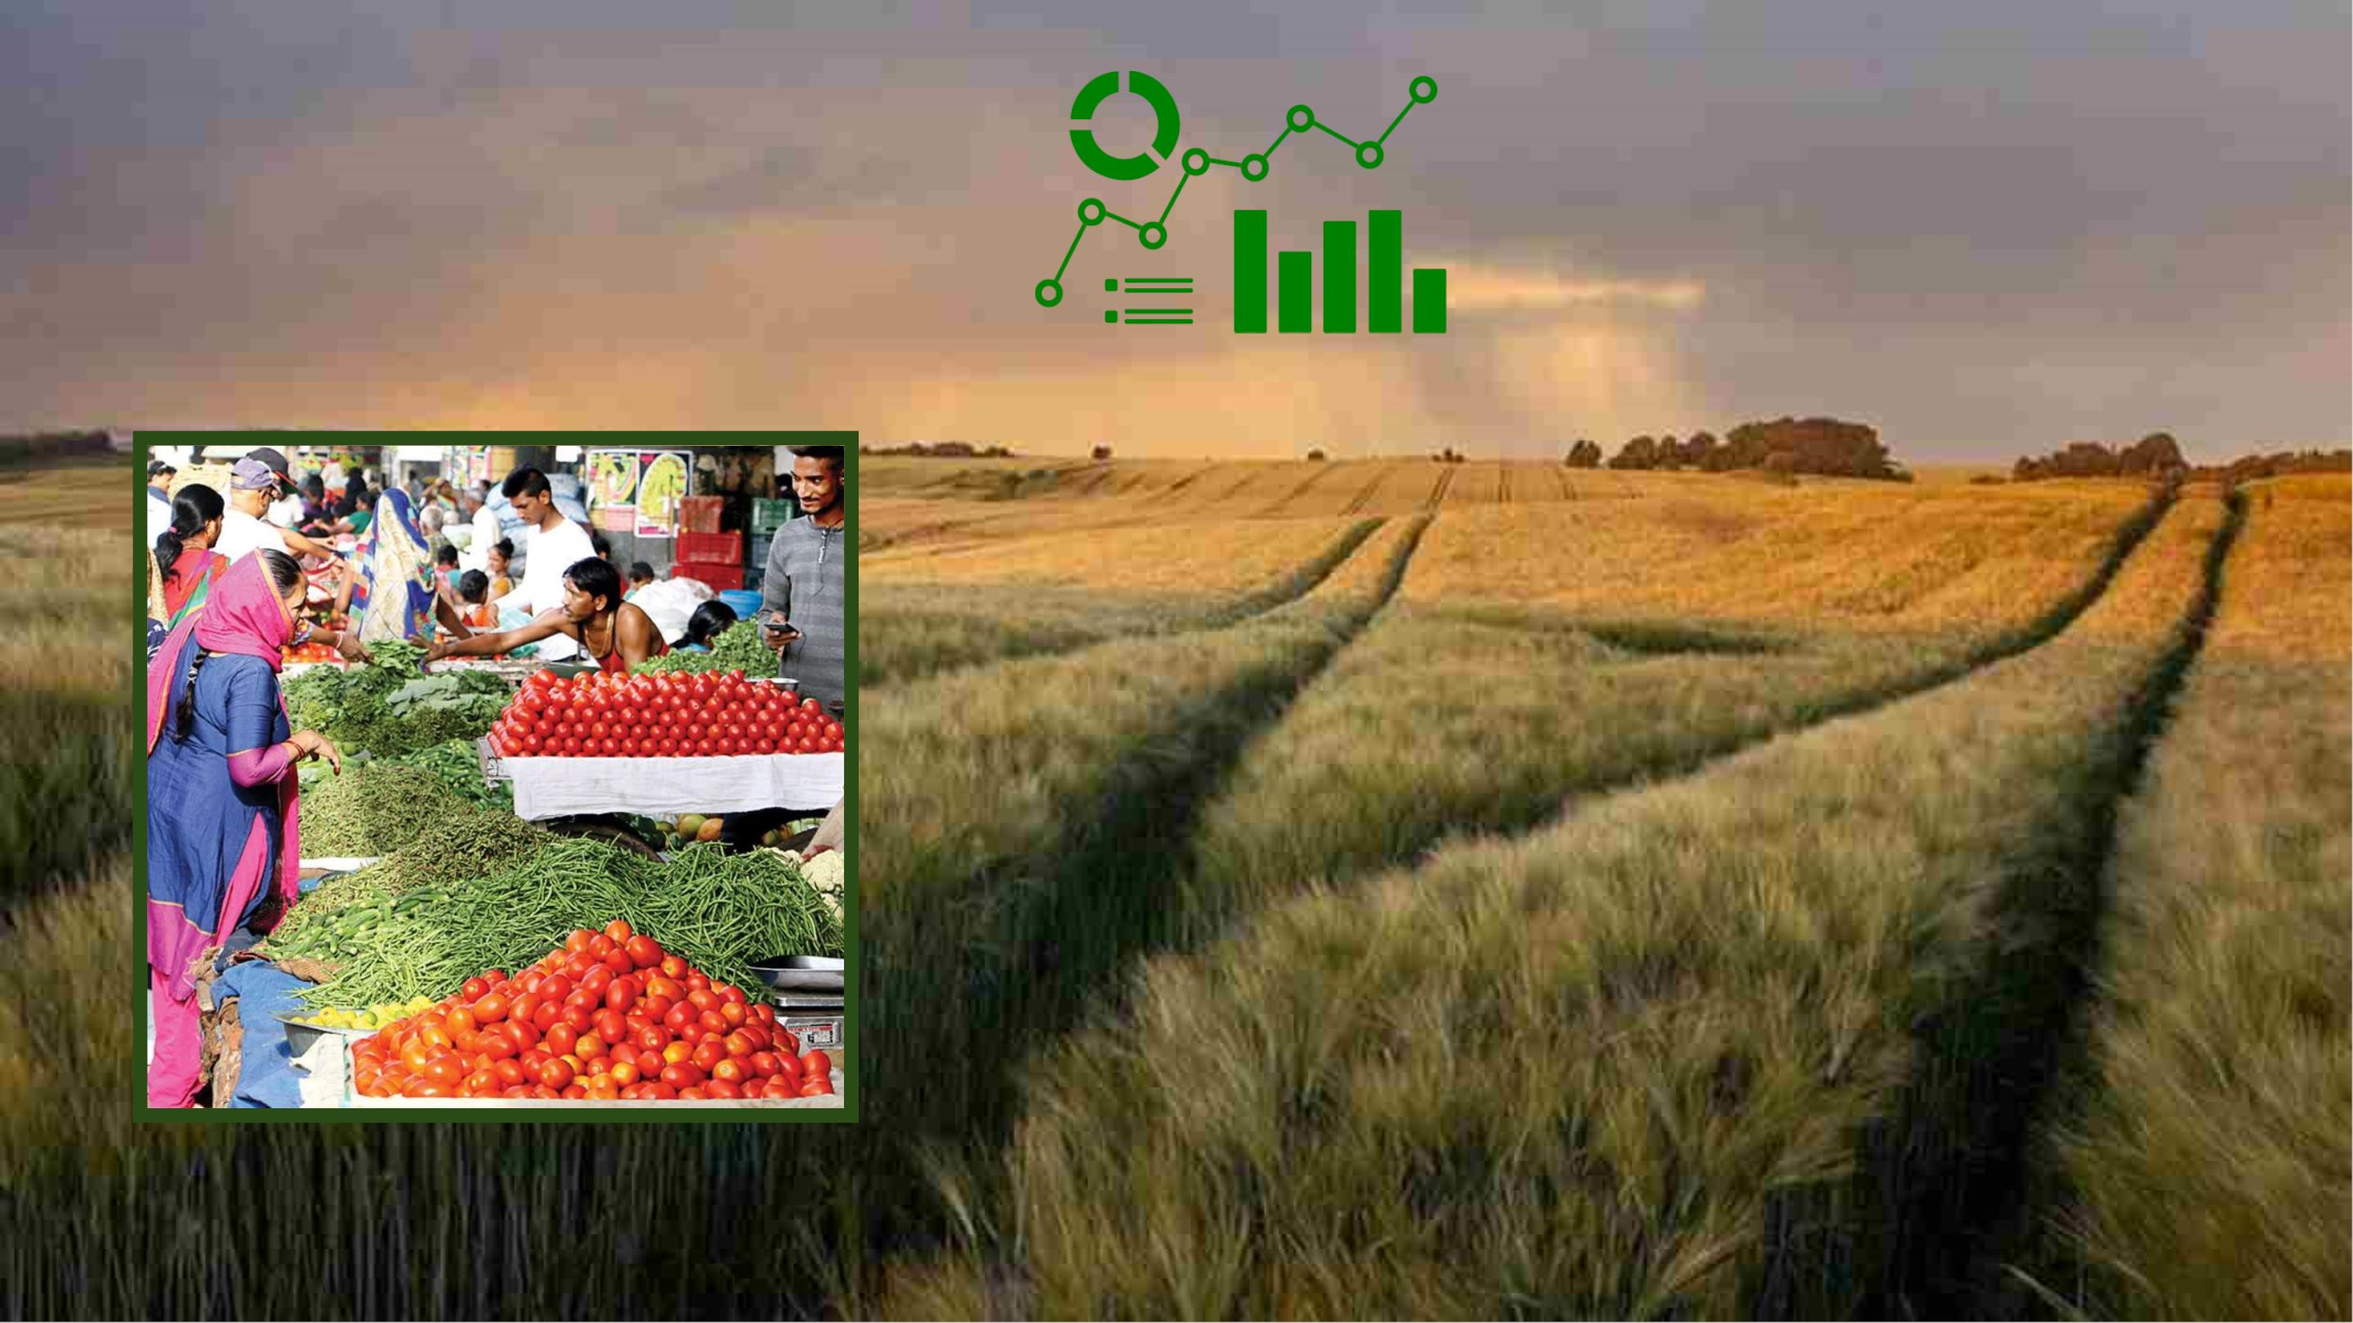

Slide 19

SuggestꢀtheꢀBestꢀCrop

Slide 20

ButꢀWeꢀDon’tꢀStopꢀHere

Slide 21
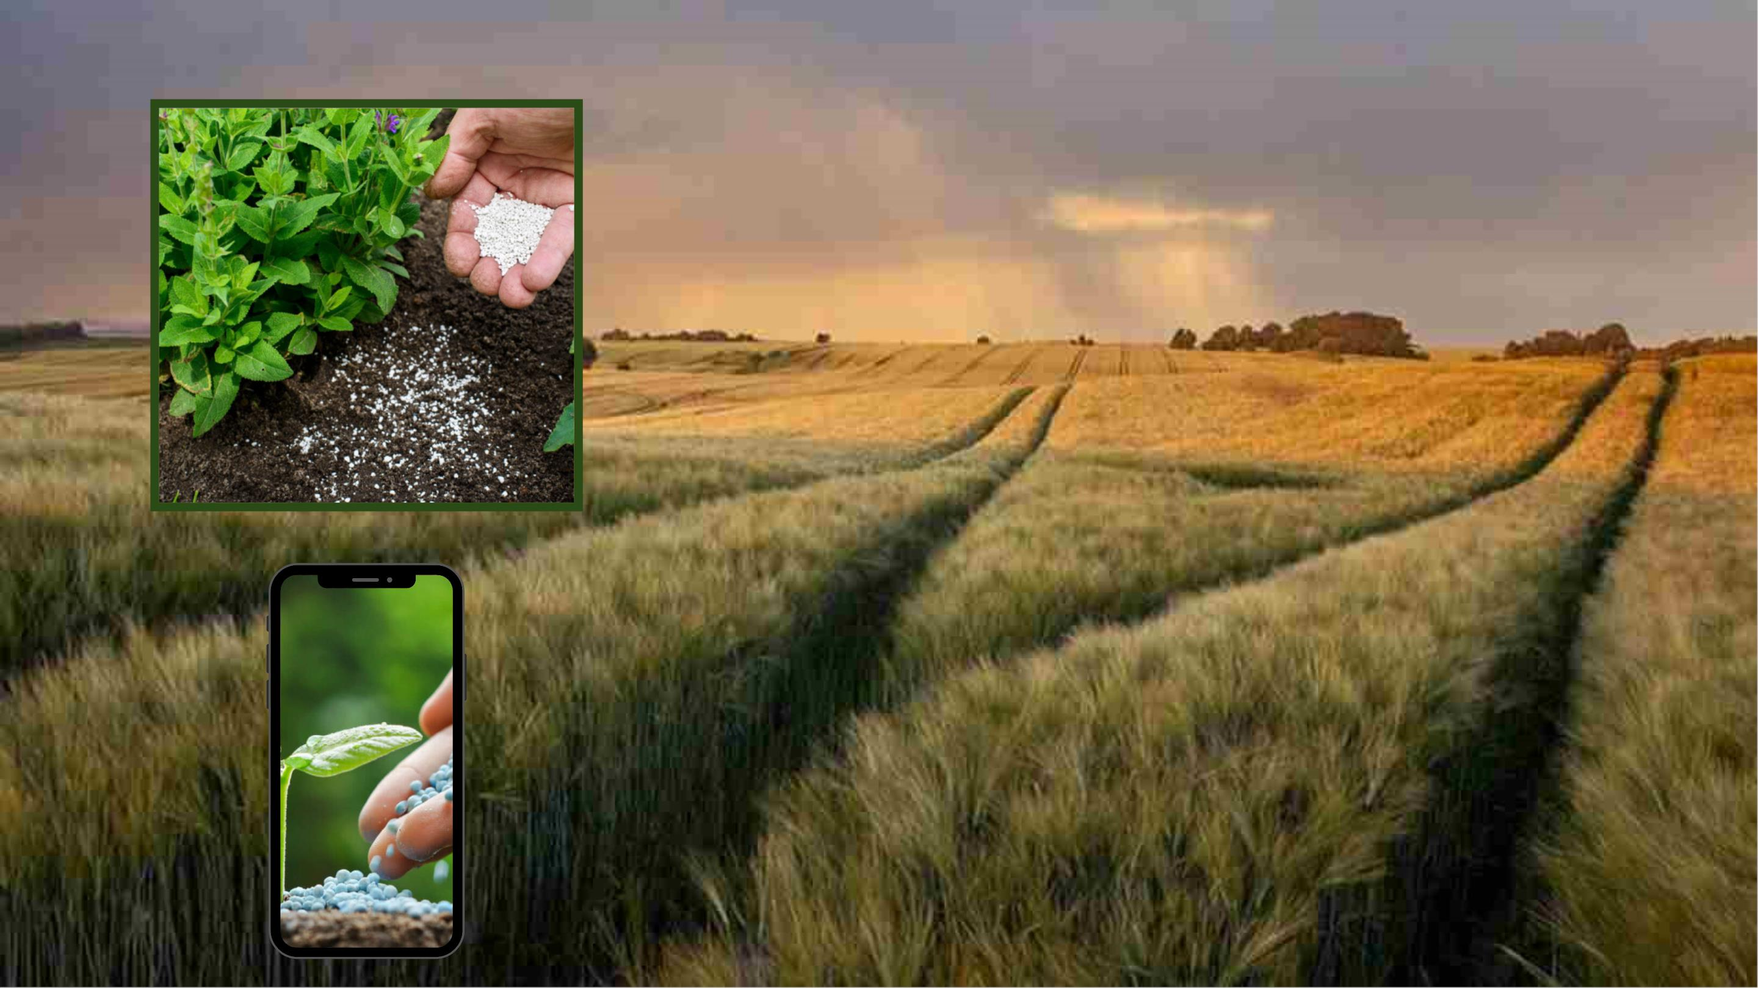

Slide 22
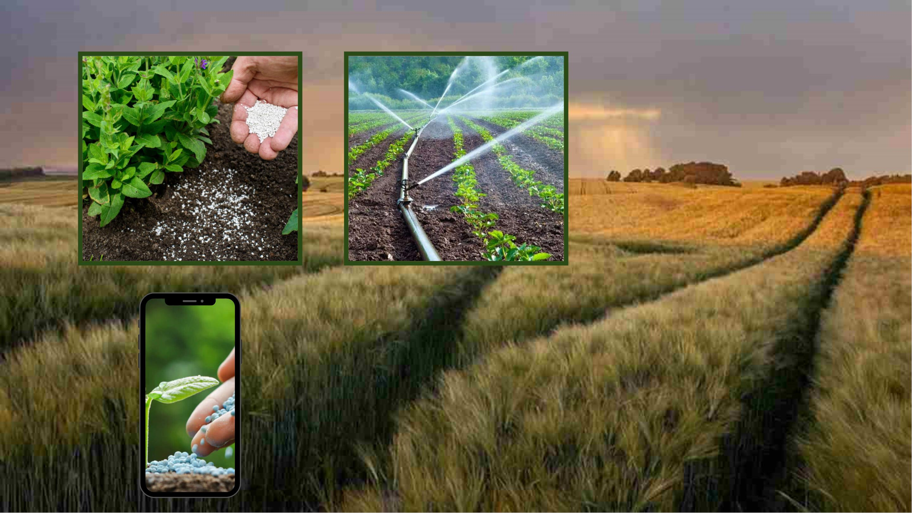

Slide 23
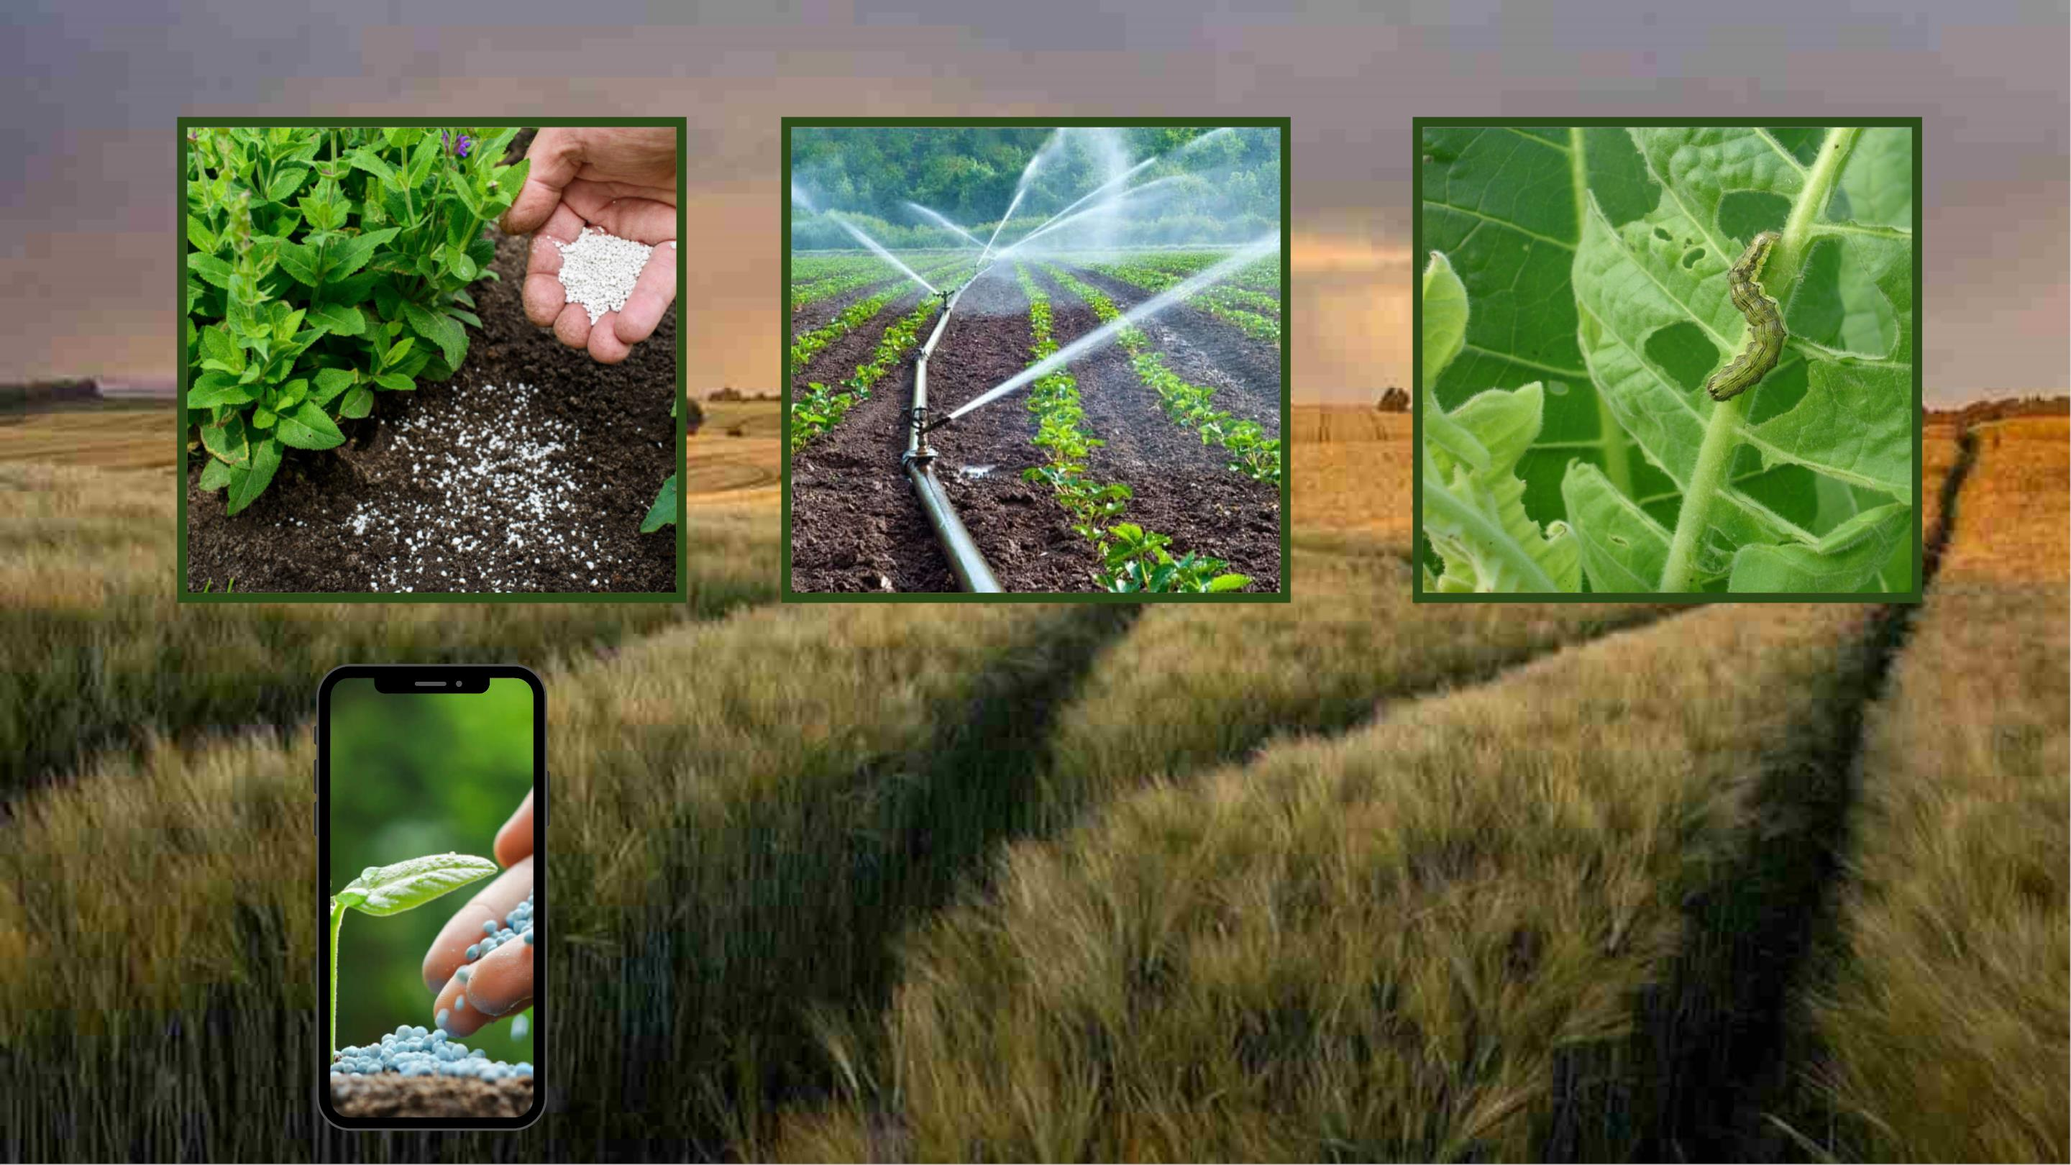

Slide 24
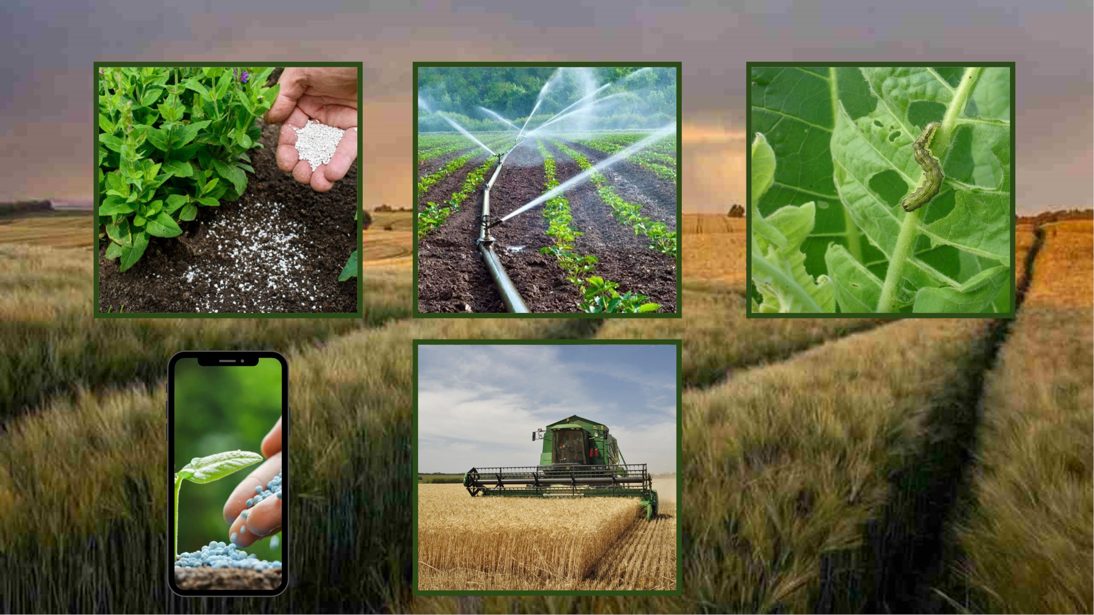

Slide 25
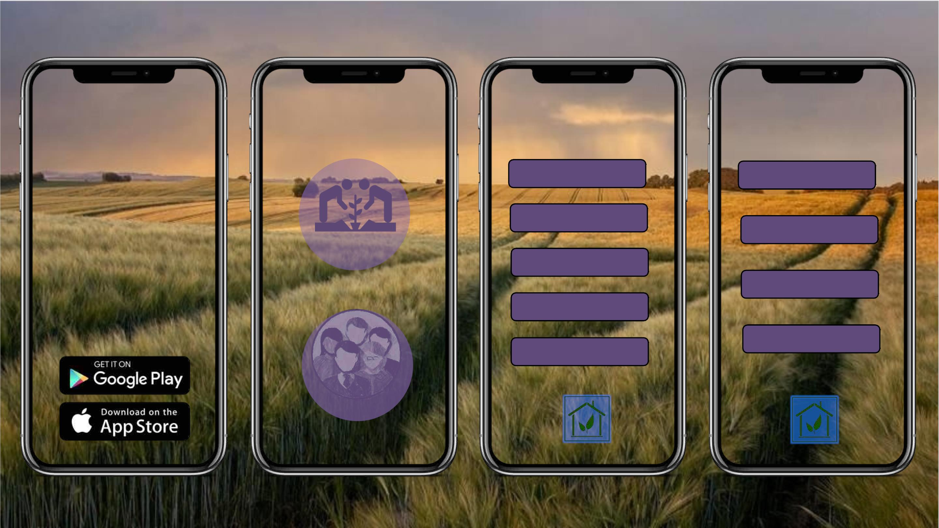
||| HAWK SENSE
|||
FARMERS
|||
USERS
HAWK SENSE
ꢀ
by
Connectꢀme
Marketꢀavailability
Farmersꢀinfo
Agriꢀmap
TECH HAWKS
Weatherꢀ
FARMERS
Userꢀinputs
Sensorꢀdata
Marketꢀavailability
Contactꢀus
USERS

Slide 26
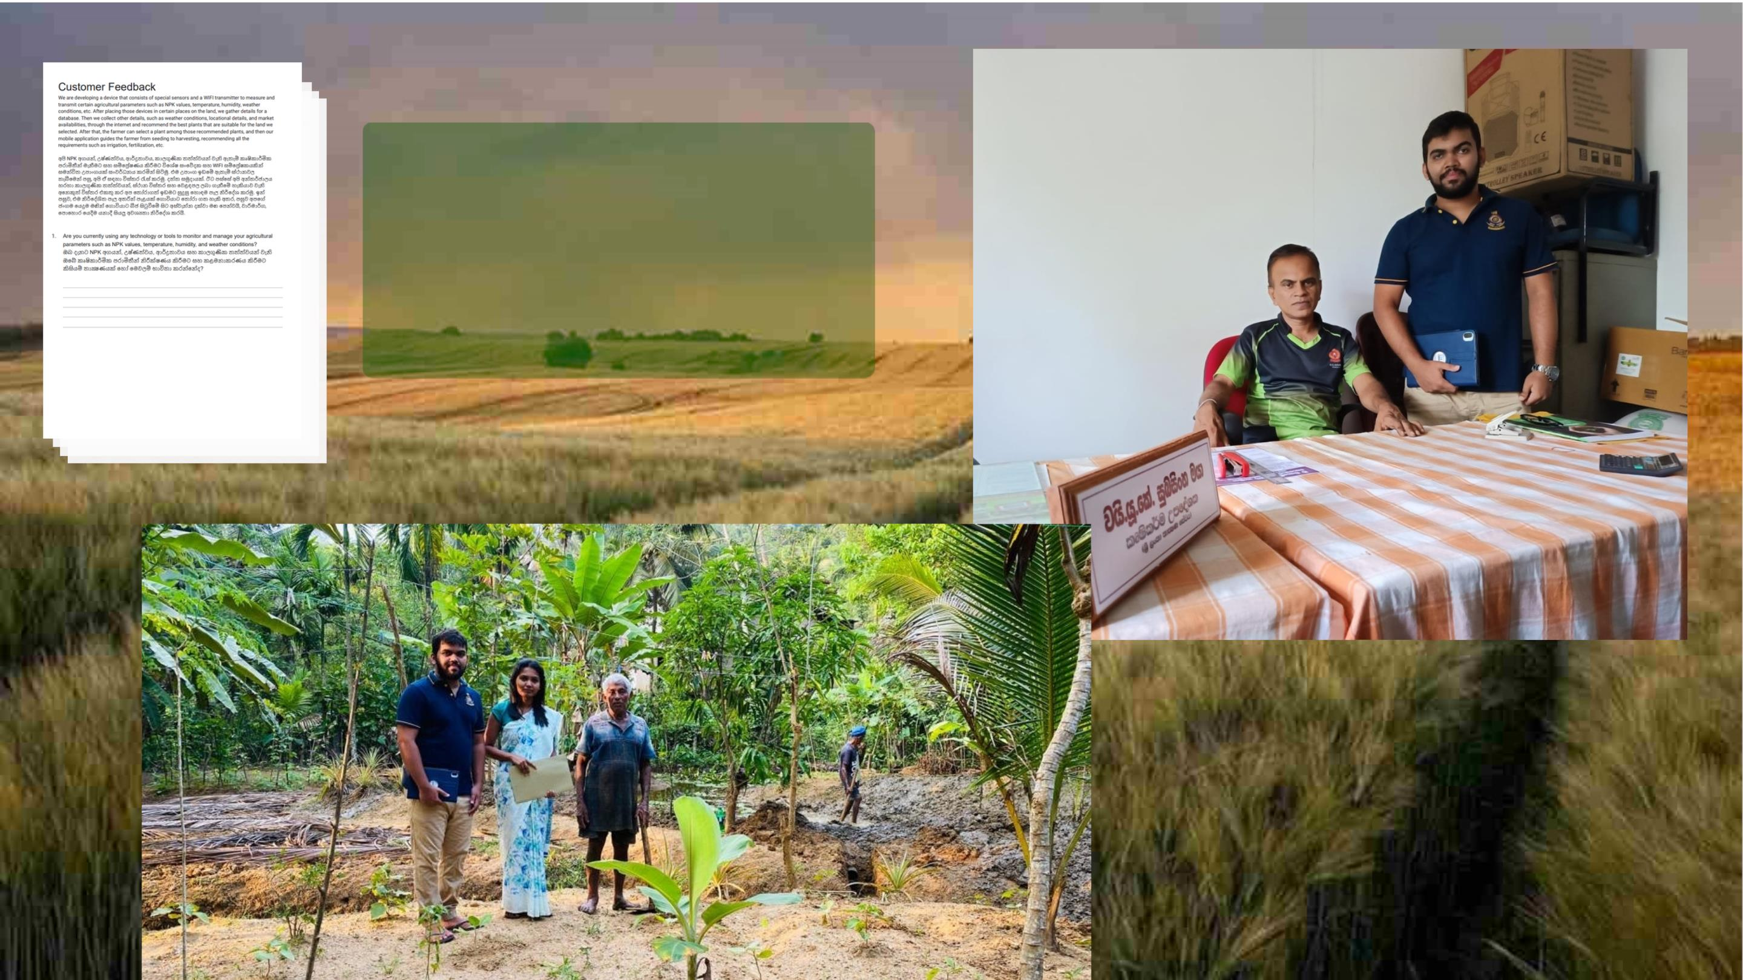
DoꢀTheyꢀReallyꢀ
NeedꢀItꢀ?

Slide 27

SUBSCRIPTIONS
3ꢀDays
7ꢀDays
Untilꢀplantꢀisꢀsecured
1ꢀunitꢀperꢀ400ꢀm2
Cropꢀselection
Guidance
Untilꢀplantꢀisꢀsecured
1ꢀunitꢀperꢀ100ꢀm2
Cropꢀselection
EntireꢀHarvesting
1ꢀunitꢀperꢀ100ꢀm2
Cropꢀselection
1ꢀunitꢀperꢀ400ꢀm2
Cropꢀselection
Futureꢀplan
Noꢀguarantee
Rs.ꢀ7499/acre
1ꢀunitꢀperꢀ400ꢀm2
Cropꢀselection
Guidanceꢀforꢀ4ꢀdays
Futureꢀplan
Noꢀguarantee
Rs.ꢀ10499/acre
Guidance
Futureꢀplan
CashbackꢀGuarantee
Rs.ꢀ29999/acre
FullꢀGuidance
Futureꢀplan
Futureꢀplan
Noꢀguarantee
Rs.ꢀ14999/acre
CashbackꢀGuarantee
Rs.ꢀ34499/acre
27

Slide 28

1.If the farmer selects a plant not recommended by us, the guarantee becomes invalid
immediately.
2.Failure to follow the provided plan disqualifies the farmer from receiving the guarantee.
3.Unforeseen critical weather changes invalidate the guarantee.
4.Unexpected damage caused by animals, insects, or other factors renders the guarantee
invalid.
ꢀꢀGUARANTEE
These conditions are subject to change at any time without prior notice, under the
authority of the executives at Tech Hawks Pvt. Company.
28

Slide 29
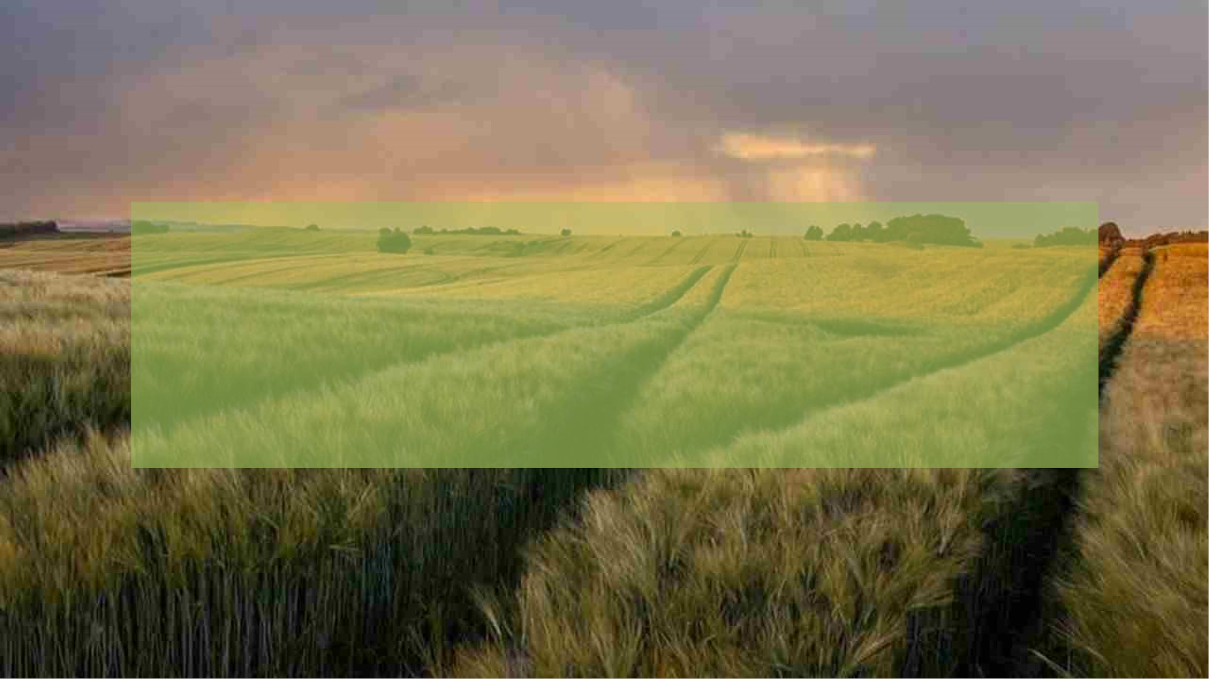
TargetꢀAudience
ꢀ1)ꢀꢀFarmers
ꢀ2)ꢀꢀAgriculturalꢀinspectors
ꢀ3)ꢀꢀGovernmentꢀandꢀnon-governmentꢀagriculturalꢀagencies
ꢀ4)ꢀꢀAnyꢀFarmingꢀEnthusiastsꢀ

Slide 30


Slide 31


Slide 32


Slide 33
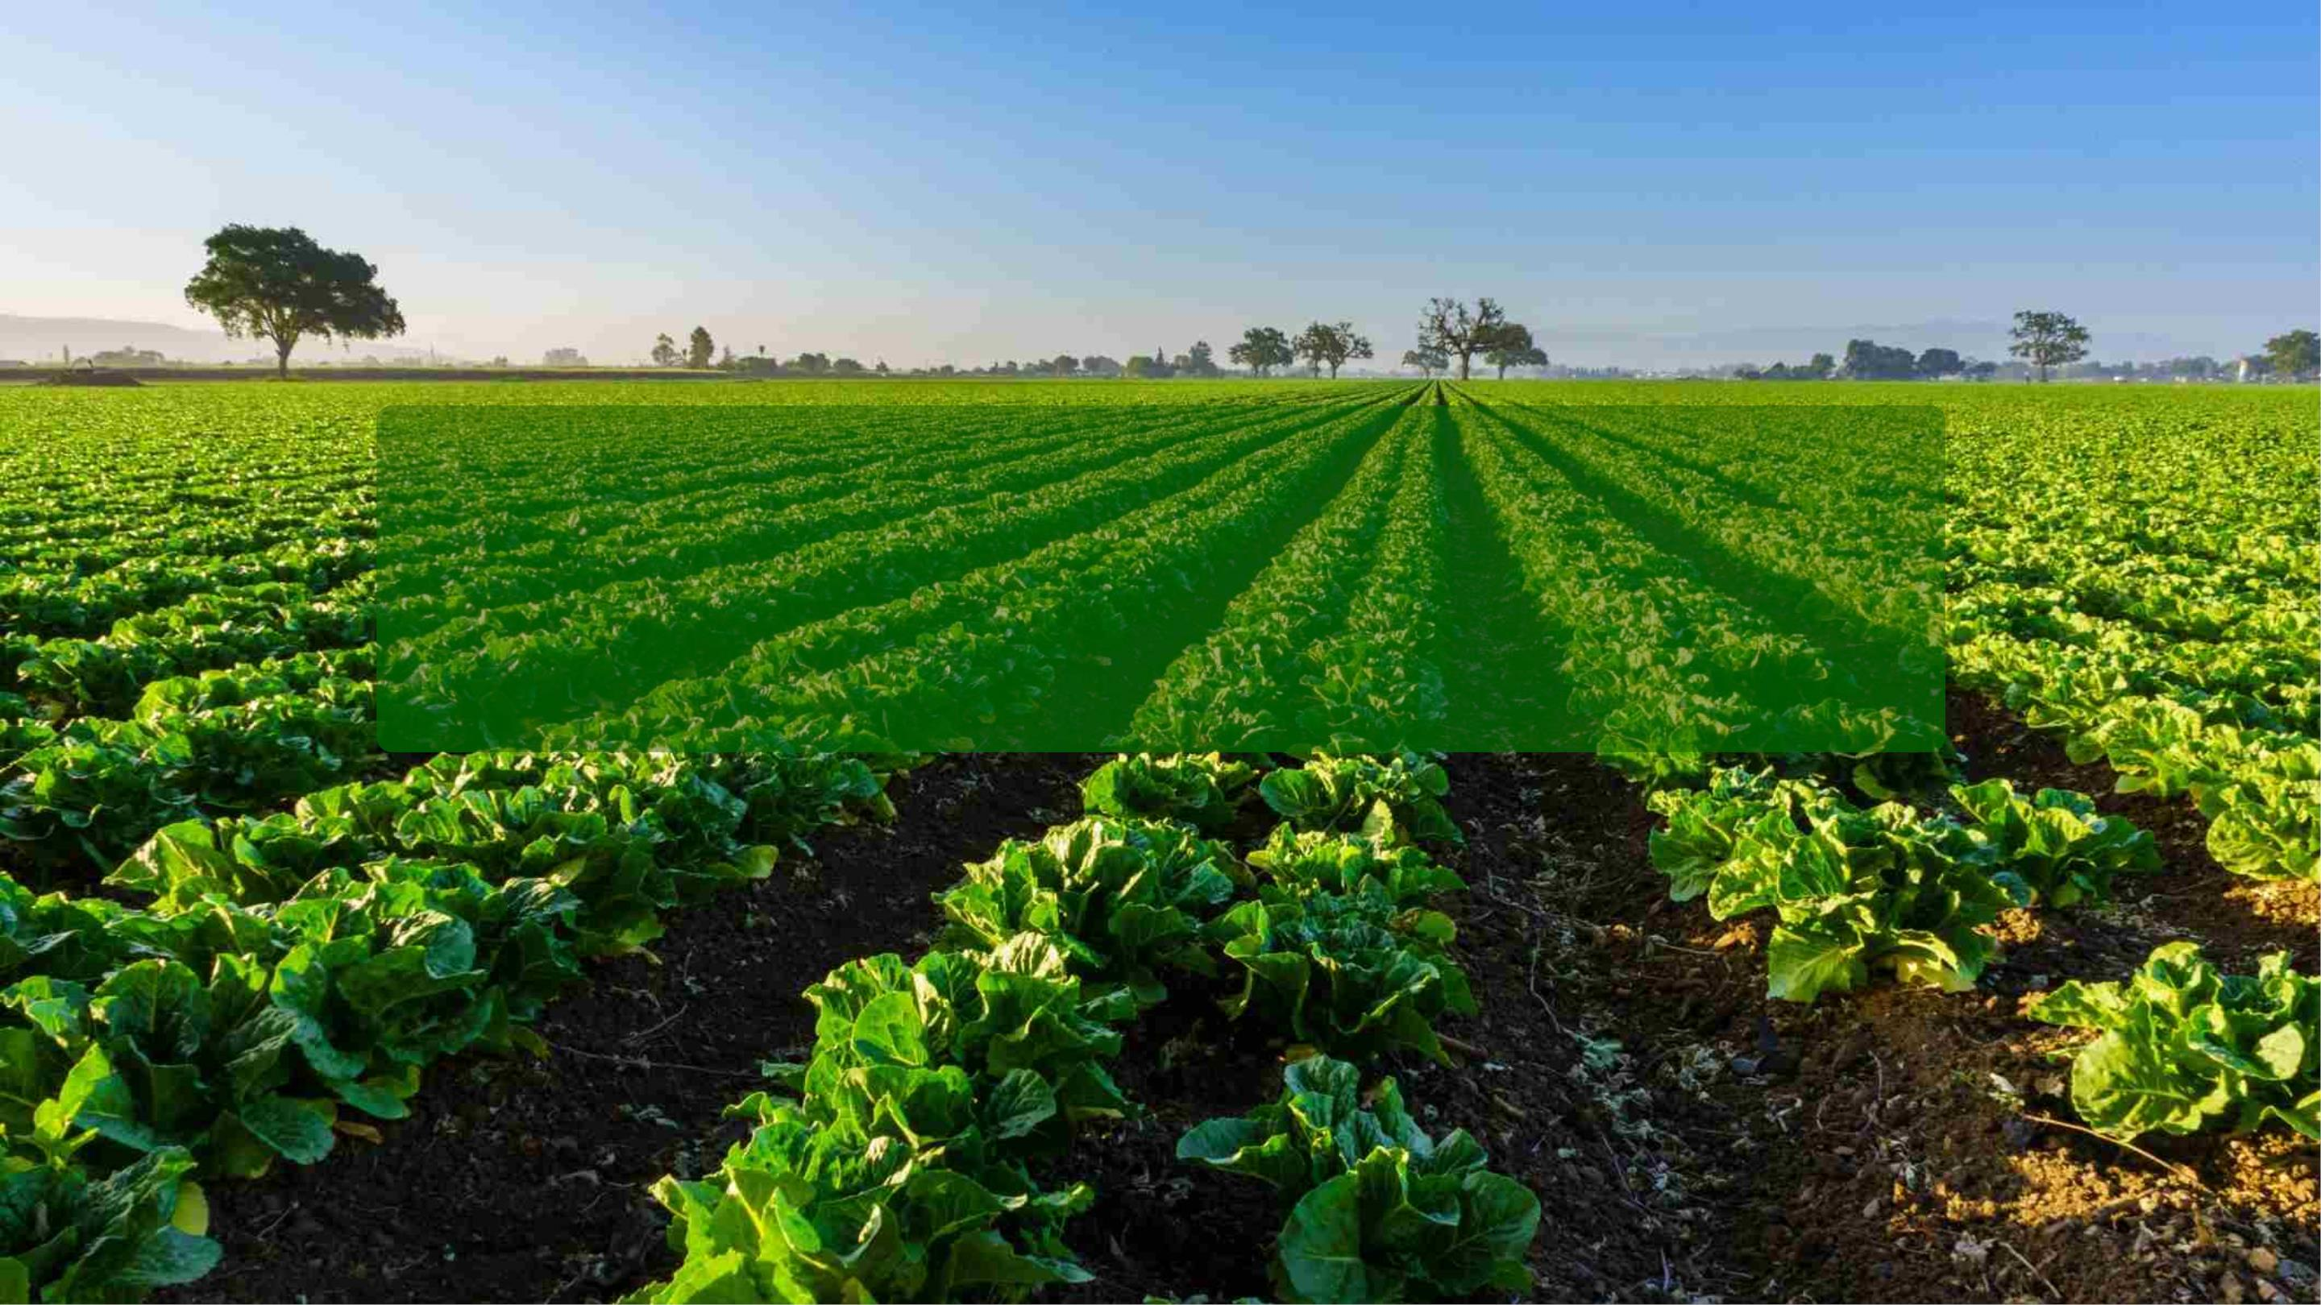
Thank You

Slide 34
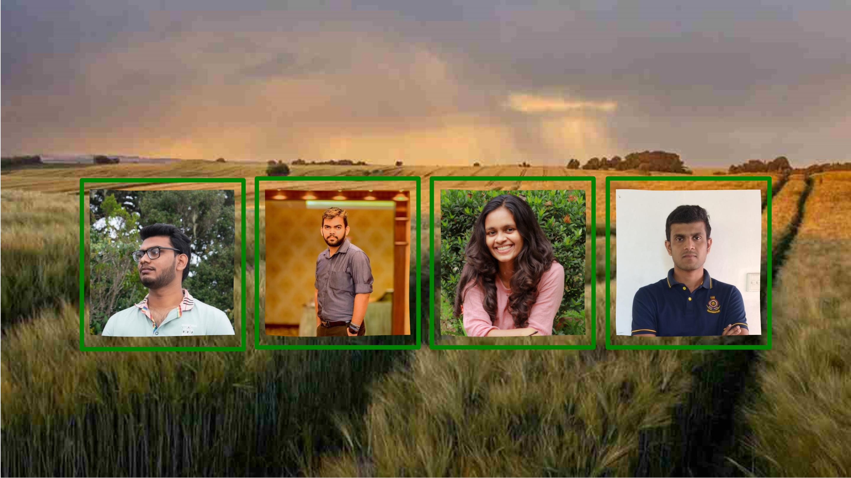
OurꢀTeam

